Slide 1
Basic Processing Unit

Slide 2
Fundamental Concepts
Processor fetches one instruction at a time and perform the operation specified.
Instructions are fetched from successive memory locations until a branch or a jump instruction is encountered.
Processor keeps track of the address of the memory location containing the next instruction to be fetched using Program Counter (PC).
Instruction Register (IR)

Slide 3
Executing an Instruction
Fetch the contents of the memory location pointed to by the PC. The contents of this location are loaded into the IR (fetch phase).
IR ← [[PC]]
Assuming that the memory is byte addressable, increment the contents of the PC by 4 (fetch phase).
PC ← [PC] + 4
(where each instruction comprises 4 bytes)
Carry out the actions specified by the instruction in the IR (execution phase).

Slide 4
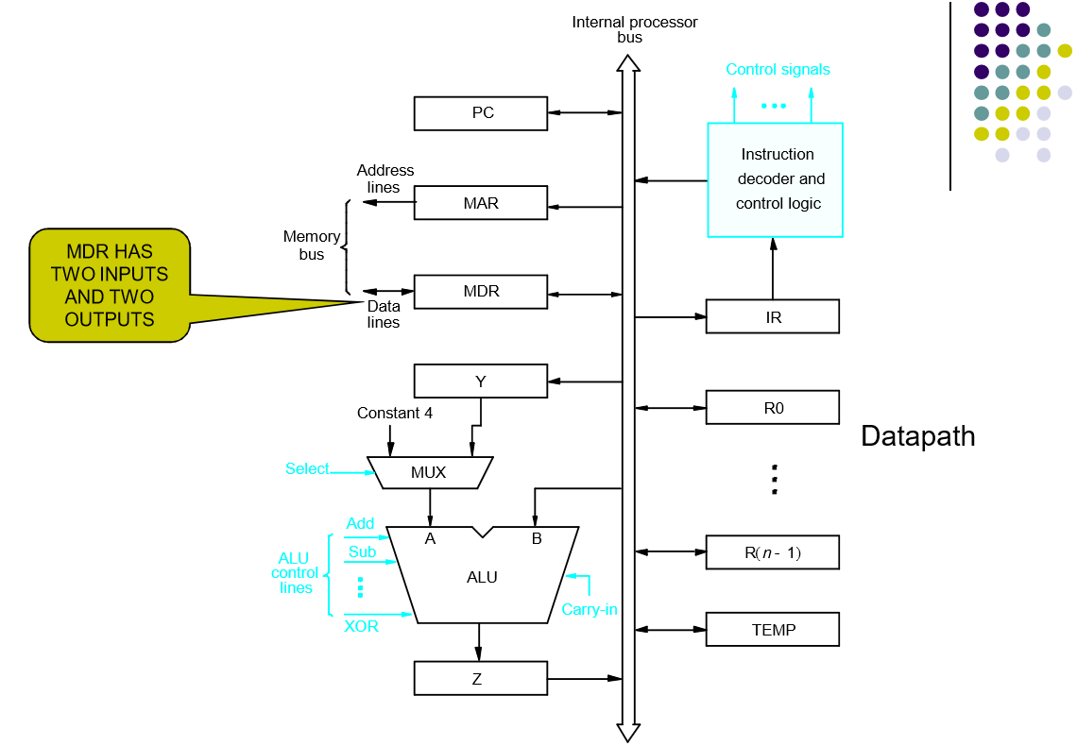
Processor Organization

Slide 5
Registers:
The processor registers R0 to Rn-1 vary considerably from one processor to another.
Registers are provided for general purpose used by programmer.
Registers Y, Z & TEMP are temporary registers used by processor during the execution of some instruction.
Multiplexer:
Select either the output of the register Y or a constant value 4 to be provided as input A of the ALU.
Constant 4 is used by the processor to increment the contents of PC.

Slide 6
ALU:
Used to perform arithmetic and logical operation.
Data Path:
The registers, ALU and interconnecting bus are collectively referred to as the data path.

Slide 7
Register Transfers
Internal processor
b
us
R
i
in
R
i
R
i
out
Y
in
Y
Constant 4
Select
MUX
A
B
ALU
Z
in
Z
Z
out
Figure 7.2. Input and output gating for the registers in Figure 7.1.

Slide 8
The input and output gates for register Ri are controlled by signals is R_{in} and R_{iout .}
If R_{in} is set to1 - data available on common bus are loaded into Ri.
If R_{iout} is set to1 - the contents of register are placed on the bus.
R_{iout} is set to 0 – the bus can be used for transferring data from other registers .

Slide 9
Data transfer between two registers:
Transfer the contents of R1 to R4.
Enable output of register R1 by setting R1_{out}=1. This places the contents of R1 on the processor bus.
Enable input of register R4 by setting R4_{in}=1. This loads the data from the processor bus into register R4.

Slide 10
Performing an Arithmetic or Logic Operation
The ALU is a combinational circuit that has no internal storage.
ALU gets the two operands from MUX and bus. The result is temporarily stored in register Z.
What is the sequence of operations to add the contents of register R1 to those of R2 and store the result in R3?
  R1_{out}, Y_{in}
  R2_{out}, Select Y, Add, Z_{in}
  Z_{out}, R3_{in}

Slide 11
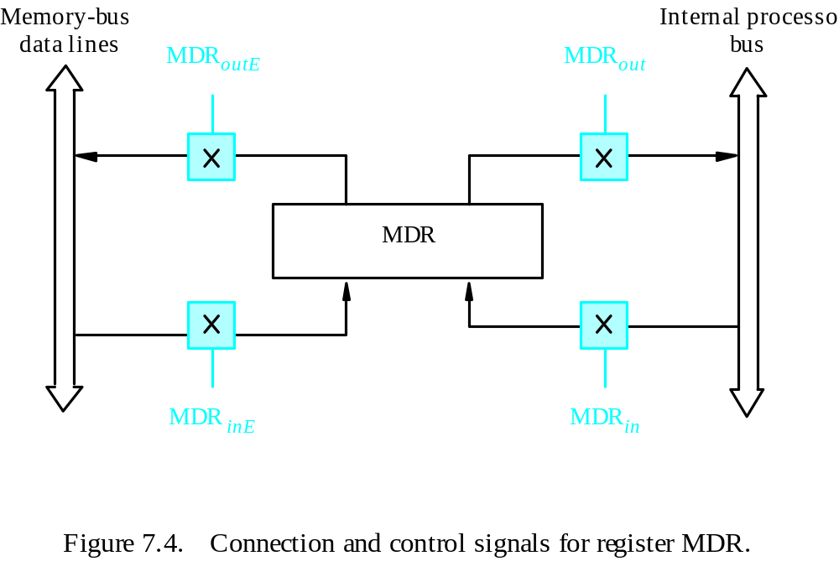
Fetching a Word from Memory
Address into MAR; issue Read operation; data into MDR.
Figure 7.4. Connection and control signals for register MDR.

Slide 12
Fetching a Word from Memory
The response time of each memory access varies (cache miss, memory-mapped I/O,…).
To accommodate this, the processor waits until it receives an indication that the requested operation has been completed (Memory-Function-Completed, MFC).
Example: Move (R1), R2
MAR ← [R1]
Start a Read operation on the memory bus
Wait for the MFC response from the memory
Load MDR from the memory bus
R2 ← [MDR]

Slide 13
Fetching a Word from Memory
Example: Move (R1), R2
MAR ← [R1]
Start a Read operation on the memory bus
Wait for the MFC response from the memory
Load MDR from the memory bus
R2 ← [MDR]
Assume MAR is always available on the address lines of the memory bus.
Move (R1), R2
R1_{out}, MAR_{in}, Read
MDR_{inE}, WMFC
MDR_{out}, R2_{in}

Slide 14
Storing a word in memory
Address is loaded into MAR
Data to be written loaded into MDR.
Write command is issued.
Example: Move R2,(R1)
R1_{out},MAR_{in}
R2_{out},MDR_{in},Write
  MDR_{outE}, WMFC

Slide 15
Execution of a Complete Instruction
Example: Add (R3), R1
Fetch the instruction
Fetch the first operand (the contents of the memory location pointed to by R3)
Perform the addition
Load the result into R1

Slide 16
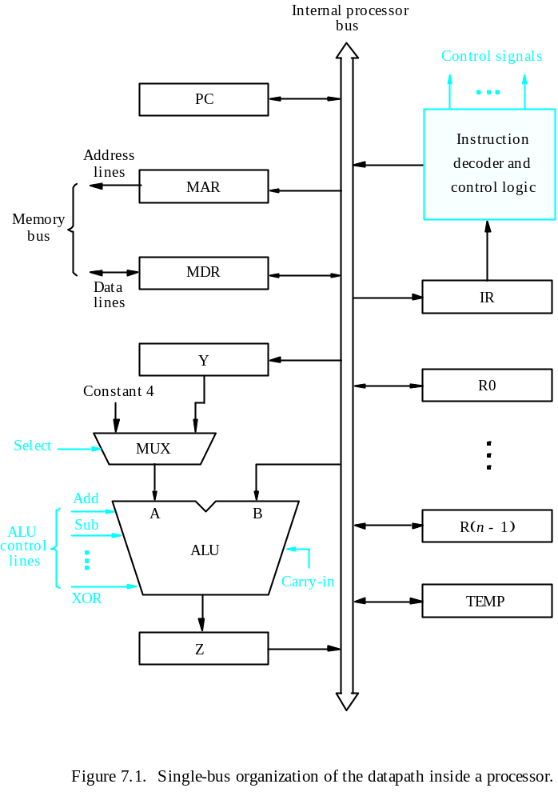
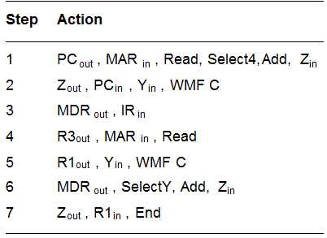
Execution of a Complete Instruction
Add (R3), R1

Slide 17
Question
Write the control sequence to execute
1. Add the (immediate) number NUM to register R1.
2. Add the contents of memory location NUM to register R1.
3. Add the contents of memory location whose address is at memory location NUM to register R1.

Slide 18
Solution 1
PC out, MAR in, Read, Select4, Add , Zin
Zout, PCin, Yin, WMFC
MDRout, IR in,
IR NUMout , Yin
R1 out, Select Y, Add, Zin
Zout, R1in, End

Slide 19
Solution 2
PC out, MAR in, Read, Select4, Add , Zin
Zout, PCin, Yin, WMFC
MDRout, IR in,
IRNUM out, MAR in, Read
R1out, Yin, WMFC
MDRout, Select Y, Add, Zin
Zout, R1in, End

Slide 20
Solution 3
PC out, MAR in, Read, Select4, Add , Zin
Zout, PCin, Yin, WMFC
MDRout, IR in
IRNUM out, MAR in, Read
WMFC
MDRout, MAR in, Read
R1out, Yin, WMFC
MDRout , SelectY, Add, Zin
Zout, R1in, End

Slide 21
Hardwired Control

Slide 22
Overview
To execute instructions, the processor must have some means of generating the control signals needed in the proper sequence.
Two categories: hardwired control and microprogrammed control
Hardwired system can operate at high speed; but with little flexibility.

Slide 23
Control Unit Organization
Clock
CLK
Control step
counter
External
inputs
Decoder/
IR
encoder
Condition
codes
Control signals
Figure 7.10. Control unit organization.

Slide 24
Generating Z_{in}
Z_{in} = T₁ + T₆ • ADD + T₄ • BR + …
Branch
Add
T
4
T
6
T
1
Figure 7.12. Generation of the Z_{in} control signal for the processor in Figure 7.1.

Slide 25
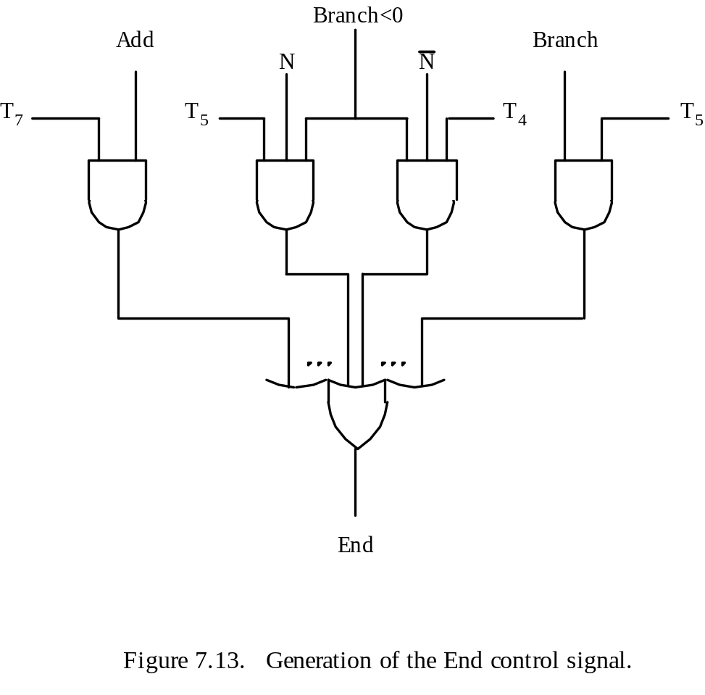
Generating End
End = T₇ • ADD + T₅ • BR + (T₅ • N + T₄ • N) • BRN +…

Slide 26
Microprogrammed Control

Slide 27
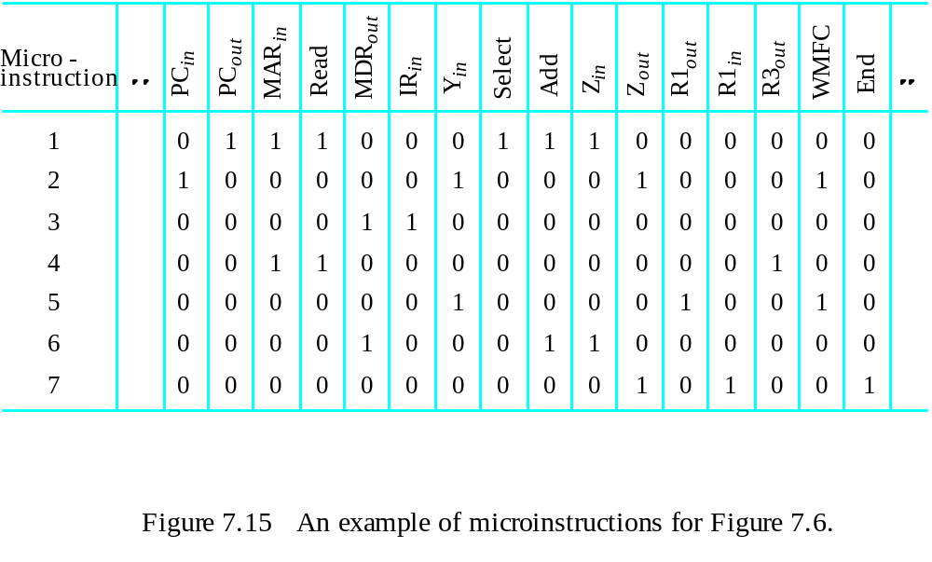
Microprogrammed Control
Control signals are generated by a program similar to machine language programs.
Control Word (CW); microroutine; microinstruction
: Textbook page430

Slide 28
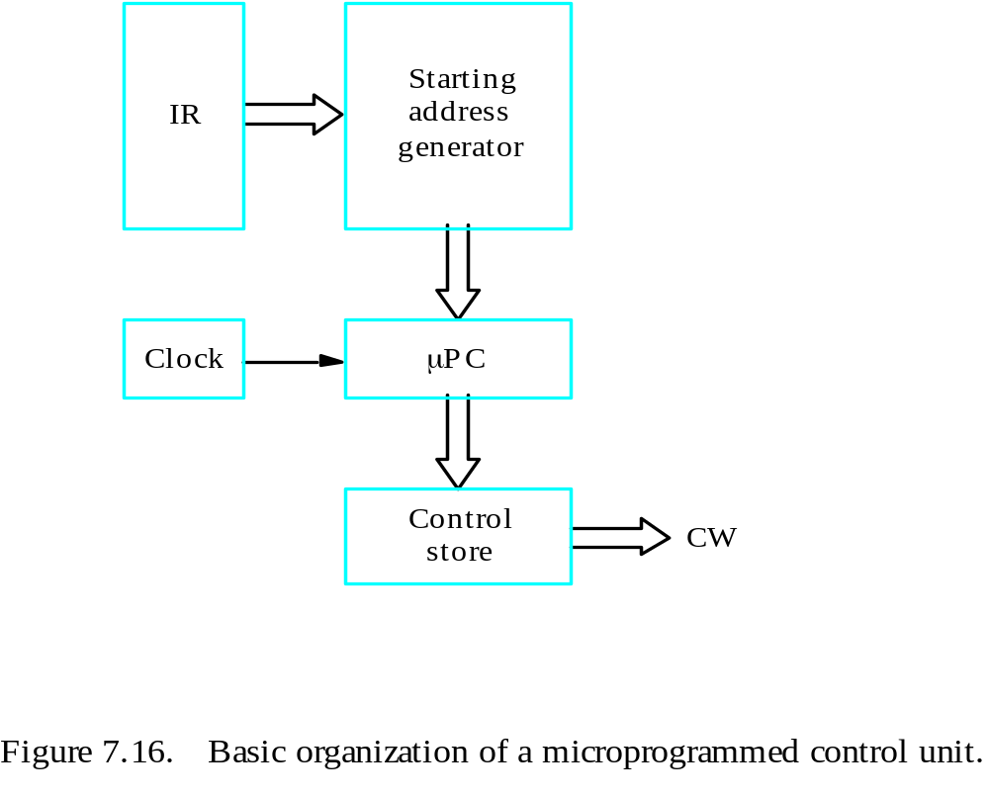
Basic organization of a microprogrammed control unit
Control store
One function
cannot be carried
out by this simple
organization.

